Slide 1


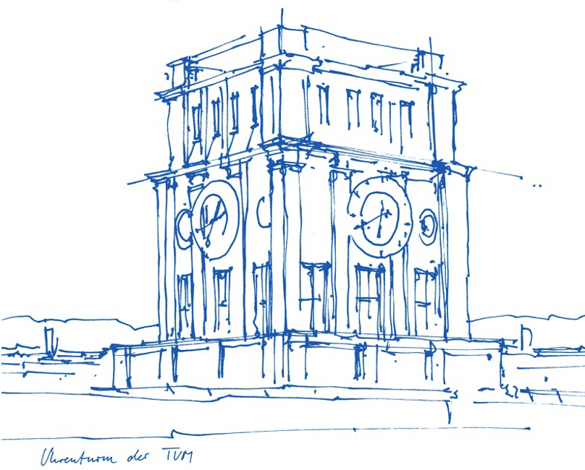
Communication-Efficient Approaches to Federated Deep Neural Networks
Bachelor’s Thesis
By: Adrian Edward Thomas Henkel
adrian.henkel@campus.lmu.de
Supervisor: Reza Nasirigerdeh
reza.nasirigerdeh@tum.de
Advisors: Prof. Dr. Jan Baumbach, and Dr. Josch Pauling
jan.baumbach@uni-hamburg.de
josch.pauling@wzw.tum.de
©2021 Technical University of Munich
1|21
Notes:
30 seconds
Populatry
Efficiency
Hughe model parameters

Slide 2
Agenda
Introduction
Deep neural networks
Federated learning
Communication-efficient approaches
Simulation framework
Datasets and models
Results
Summary and outlook
©2021 Technical University of Munich
2|21
Notes:
30 seconds

Slide 3
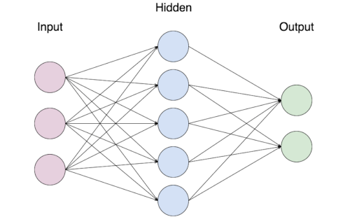
A typical neural network
Architecture:
One Input layer
One or multiple hidden layers
One output layer
Training process:
Initiate the model with random weights
Iteratively update the network to minimize a loss function
In each iteration:
Select a subset of the training data (batch)
Find updated weights that optimize the loss function of the batch (backpropagation)
©2021 Technical University of Munich
3|21
Notes:
3 min

Slide 4
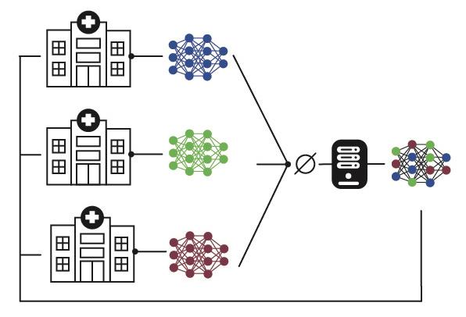
Federated learning
Multiple clients train a global model under the coordination of a central server
Each client trains the model on its local data
Each client shares the updated model with the server
The server computes the global model by taking the weighted average over the updated local models from the clients
The server sends the global model back to the clients
Repeat step 1-4 until the global model converges
1
2
3
4
©2021 Technical University of Munich
4|21
Notes:
1.30

Slide 5
FL - Challenges
Privacy
Reconstruction of the private data from the model parameters is possible in FL
Network communication
A huge amount of traffic might be exchanged over the network in FL
Heterogeneous configurations
Clients with various computational and communication speeds
Non-IID (Independent and Identically Distributed) data across clients
In this work, we focus on the network communication challenge in deep neural networks.
©2021 Technical University of Munich
5|21
Notes:
30 seconds

Slide 6
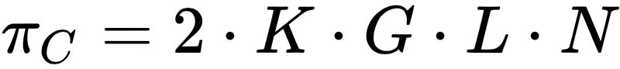
FL - Network bandwidth usage
K = number of clients
G = number of model parameters
L = size of each model parameter in bits
N = number of iterations (communication rounds)
π_{C} = network bandwidth usage
Communication-efficient approaches
Gradient quantification ( L)
Gradient sparsification ( G)
More local updates ( N)
Example:
K = 50
G = 1.000.000
L = 32
N = 200
≈ 80GB
©2021 Technical University of Munich
6|21
Notes:
1 min

Slide 7
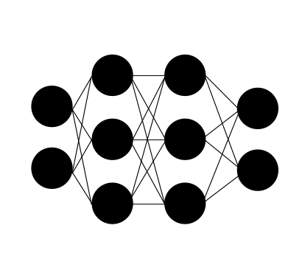
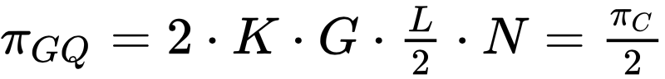
Gradient quantification (GQ)
Default size of a parameter is 32 bits (L=32)
Reduce the size of each parameter to 16 bits before sending the model
The gradients are re-transformed into 32-bit representation before training
©2021 Technical University of Munich
7|21
Notes:
30 seconds

Slide 8
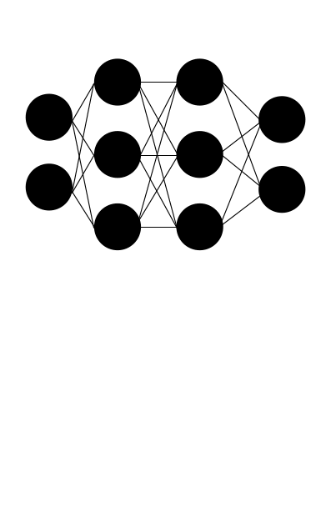
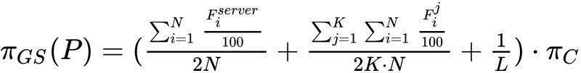
Gradient sparsification (GS)
A model might be over-parameterized
Calculate the difference between the global model and the updated model
Eliminate all parameters under a Percentile P and determine their positions from a binary matrix
Send the sparse model and the binary matrix
Parameter after training
Parameter over the percentile
Old parameters of the global model
©2021 Technical University of Munich
8|21
Notes:
1 min

Slide 9
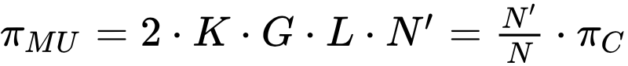
More local updates (MU)
Typically the number of local updates (E) is one
Increase of the local updates in one iteration
Faster convergence of the global model
-> less iterations
©2021 Technical University of Munich
9|21
Notes:
30 seconds

Slide 10
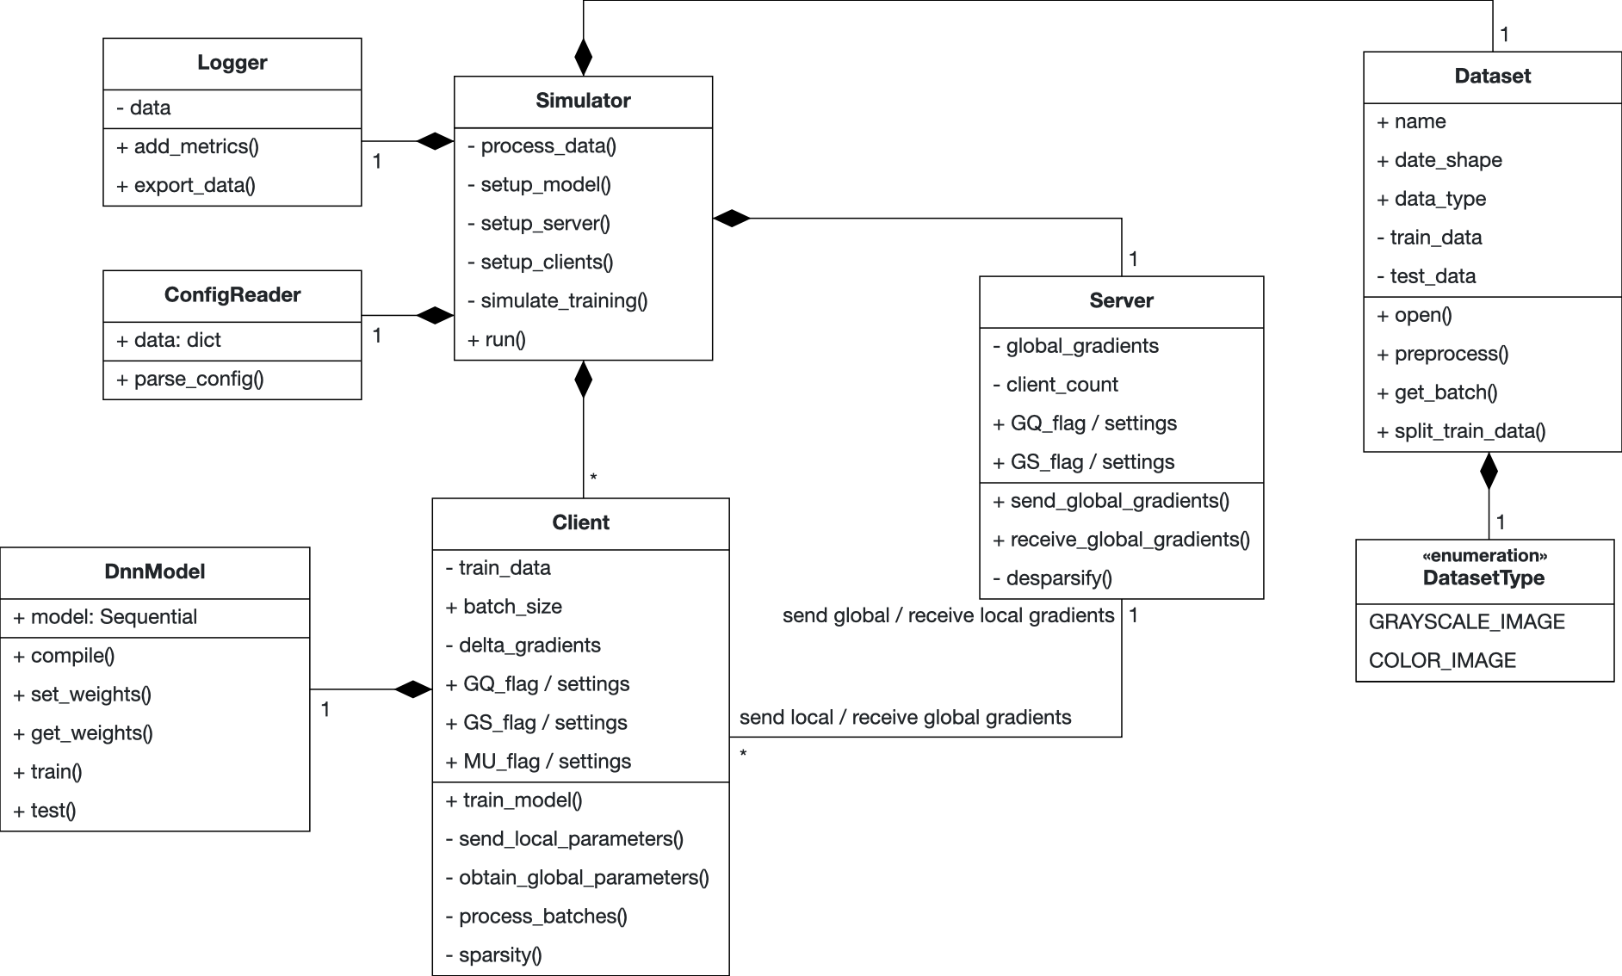


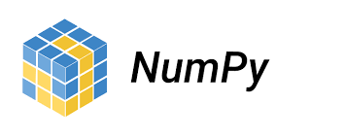
Simulation framework
Repository: https://gitlab.lrz.de/000000000149C8EB/com-eff
©2021 Technical University of Munich
10|21
Notes:
2 min

Slide 11
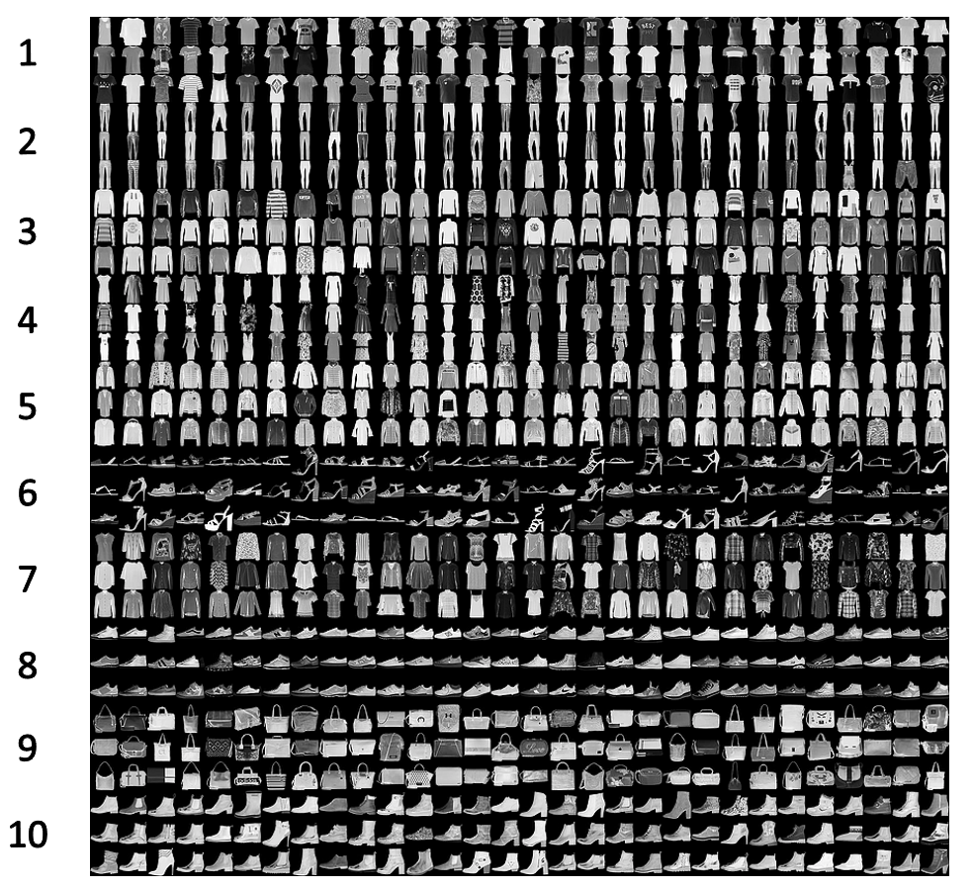
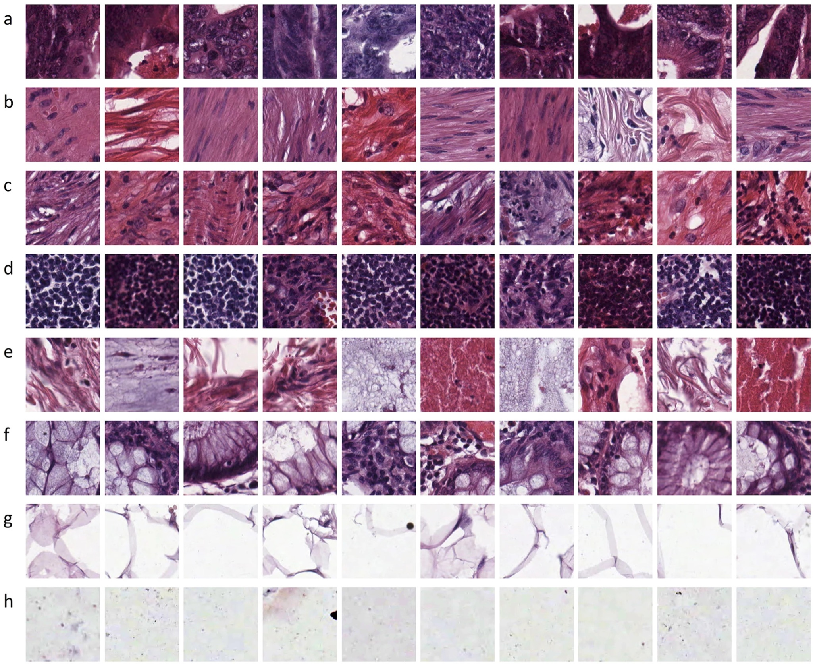
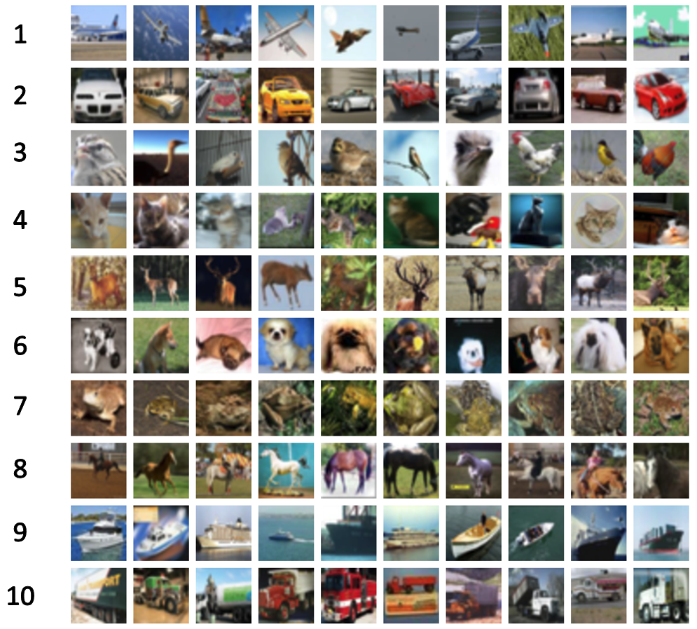
Datasets
CIFAR-10
Created 2009
Subset of tiny image DB
60000 samples
32 x 32 px. RGB
10 classes
Fashion-MNIST:
Created 2017
Zalando assortment
70000 samples
28 x 28 px. grayscale
10 classes
Colorectal Histology Dataset:
Created 2009
4000 samples
150 x 150 px. RGB
8 classes
©2021 Technical University of Munich
11|21
Notes:
1.30 min

Slide 12
Models
2CFNN
Two convolutional layers
Two Max-Pooling layers
Dense layer with 512 neurons as penultimate layer
Total of 1,633,370 trainable parameters
3CFNN
Three convolutional layers
Two Max-Pooling layers
Dense layer with 1024 neurons as penultimate layer
Total of 9,878,794 trainable parameters
VGG16
Five blocks of two or three convolutional layers
Convolutional layers are ranging from 64 to 512 filters
Total of 65,087,304
©2021 Technical University of Munich
12|21
Notes:
1.30 min

Slide 13
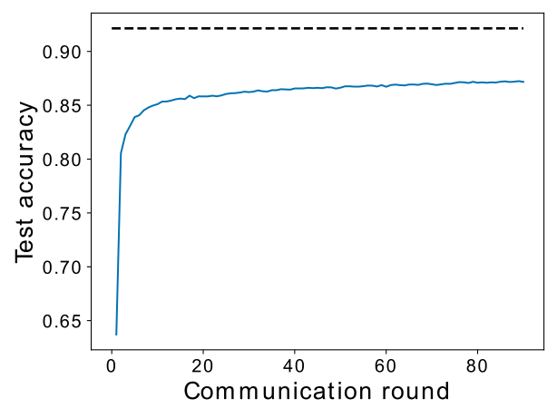
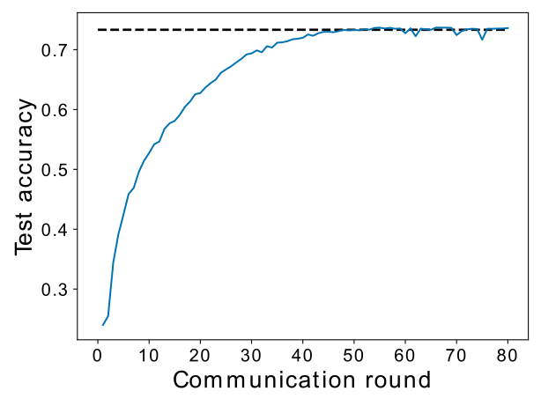
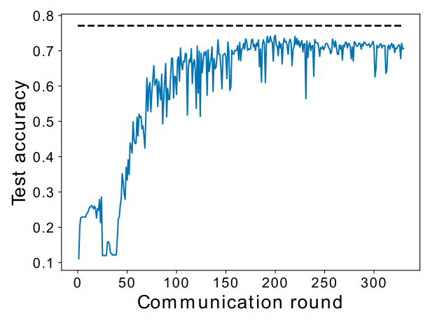
Results - Accuracy
Gradient quantification
2CFNN - FMNIST
3CFNN - CIFAR-10
VGG16 - CCH
©2021 Technical University of Munich
13|21
Notes:
1min

Slide 14
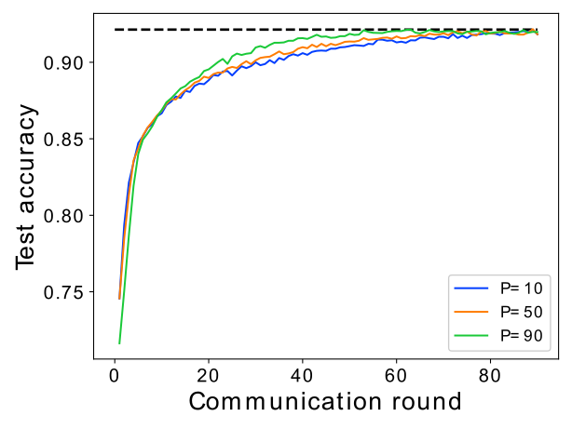
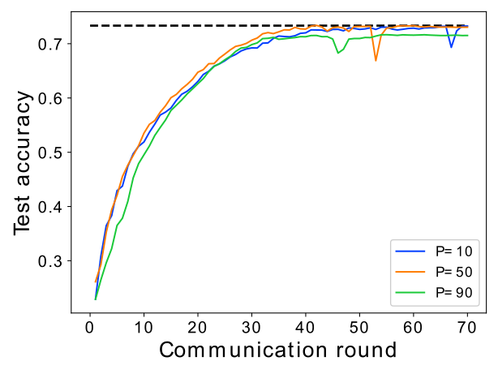
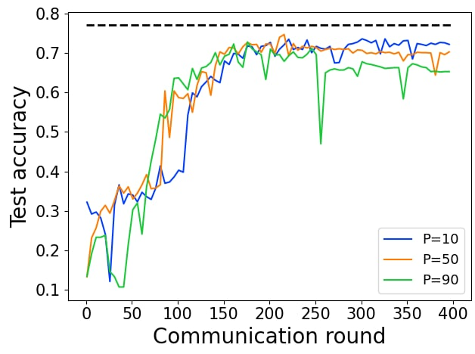
Results - Accuracy
Gradient sparsification
2CFNN - FMNIST
3CFNN - CIFAR-10
VGG16 - CCH
©2021 Technical University of Munich
14|21
Notes:
1min

Slide 15
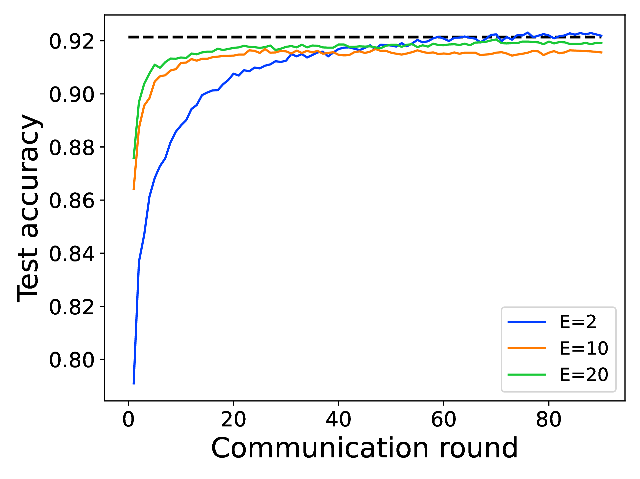
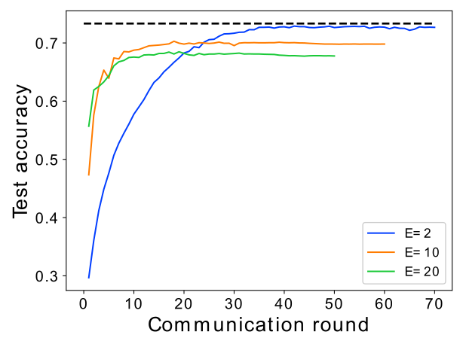
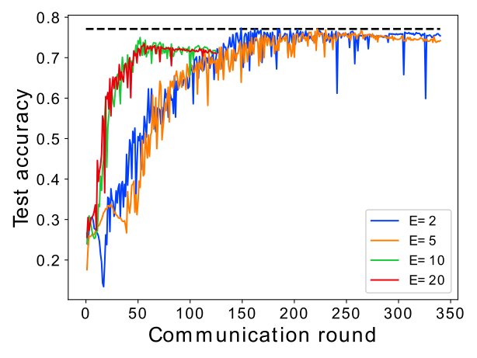
Results - Accuracy
More local updates
2CFNN - FMNIST
3CFNN - CIFAR-10
VGG16 - CCH
©2021 Technical University of Munich
15|21
Notes:
1min

Slide 16
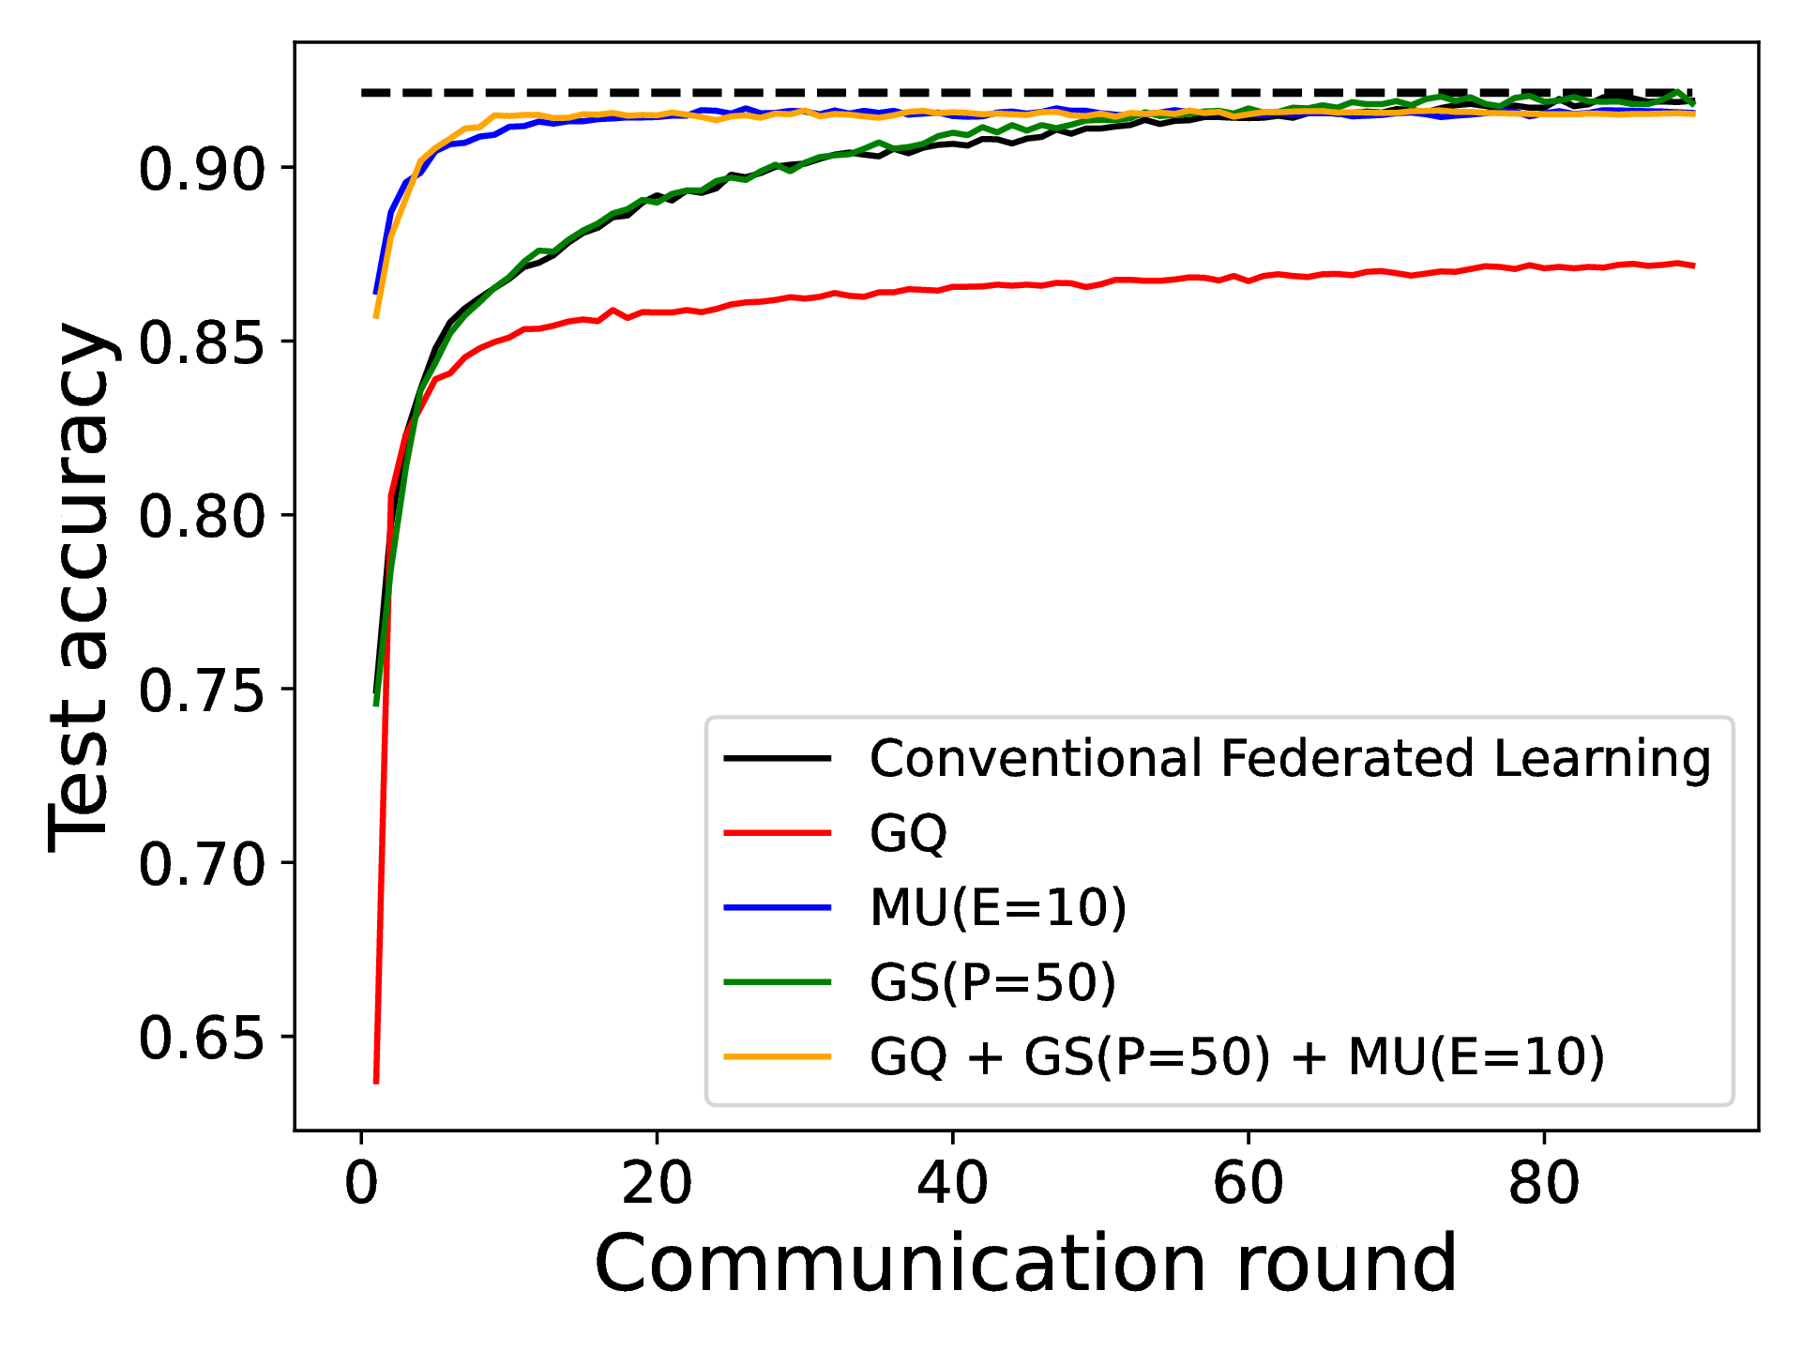
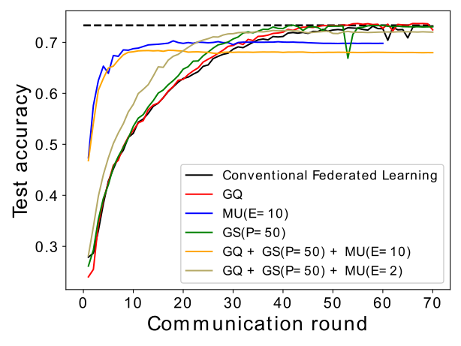
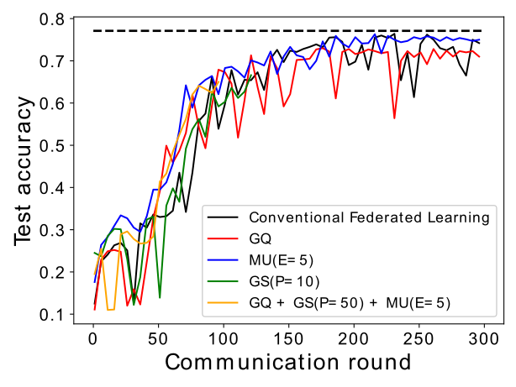
Results - Accuracy
Combinations
2CFNN - FMNIST
3CFNN - CIFAR-10
VGG16 - CCH
©2021 Technical University of Munich
16|21
Notes:
1min

Slide 17
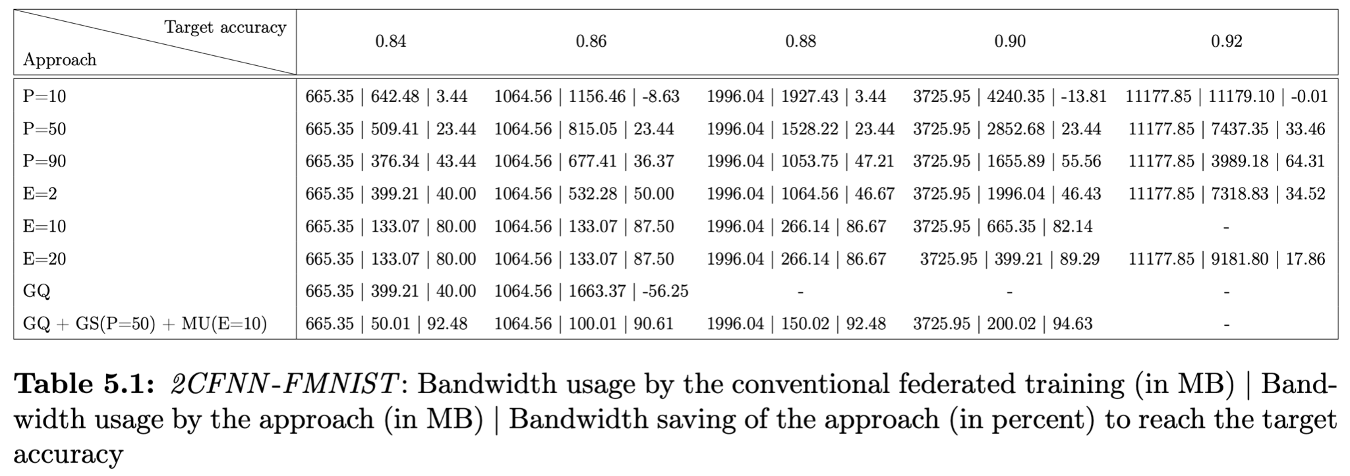
Results - Bandwidth usage
©2021 Technical University of Munich
17|21
Notes:
1min

Slide 18
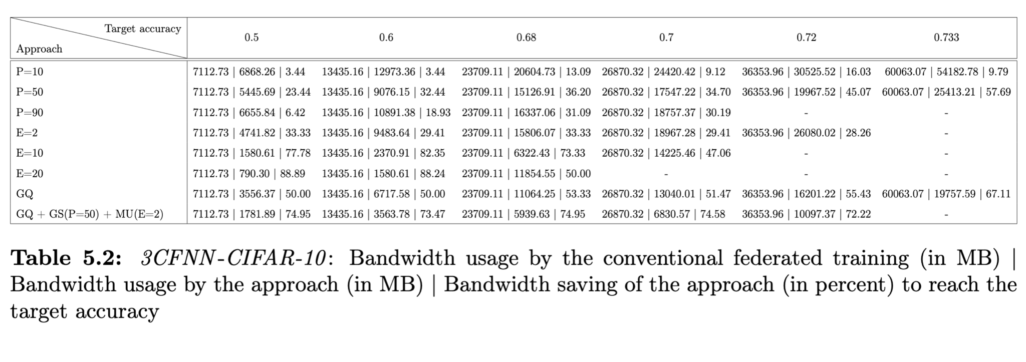
Results - Bandwidth usage
©2021 Technical University of Munich
18|21
Notes:
1min

Slide 19
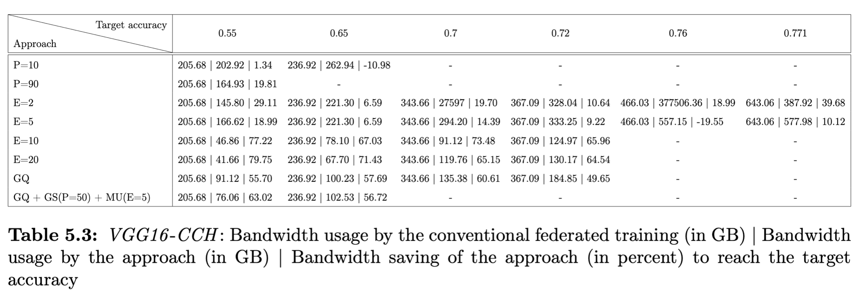
Results - Bandwidth usage
.
©2021 Technical University of Munich
19|21
Notes:
1min

Slide 20
Summary
All three approaches can significantly save the network bandwidth but also affect the accuracy of the models
The More local update approach is the most suitable choice taking communication efficiency and accuracy into account
The More local update approach is the most contributing approach in the combination
Combining the approaches provides further bandwidth savings in comparison with each individual approach
©2021 Technical University of Munich
20|21
Notes:
1 min

Slide 21
Outlook
Gradient sparsification
Multi-threaded implementation (one thread per layer) to improve the sparsification speed
Server-side sparsification
Communication-efficient approaches in
Non-IID label distributions
Imbalanced sample size distributions
©2021 Technical University of Munich
21|21
Notes:
1 min

